Slide 1

Security
Computer System Engineering, Fall 2019. (IPADS, SJTU)
Secure Channel & Local Security
Yubin Xia

Slide 2

Review: Key Problem of Password
Key problem: once you send a password to the server, it can impersonate you
Solved part of the problem by hashing the password database
But still sending the password to the server to verify on login
MITM attack: man-in-the-mirror

Slide 3
Adversary in the Network
What can adversary in the network do?
Observe packets
Corrupt packets
Inject packets
Drop packets
…

Slide 4
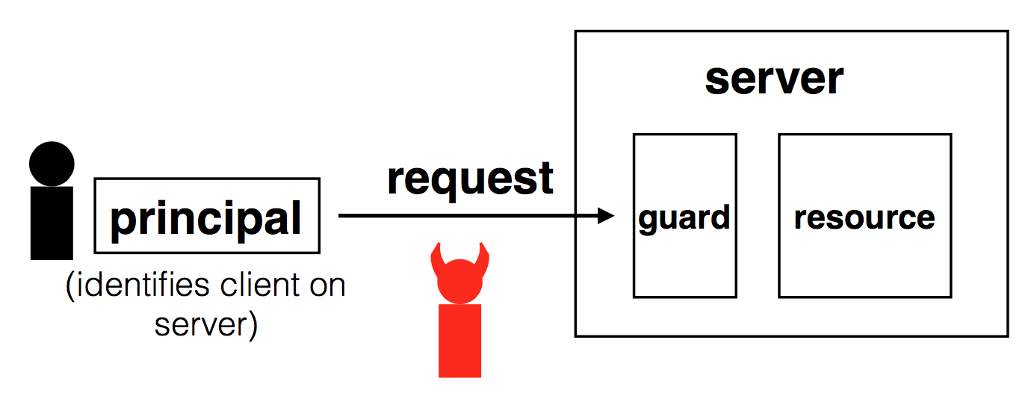
Review: Security Goals
Confidentiality: adversary cannot learn message contents
Integrity: adversary cannot tamper with message contents
(if they do, client and/or server will detect it)

Slide 5
Secure Channel

Slide 6
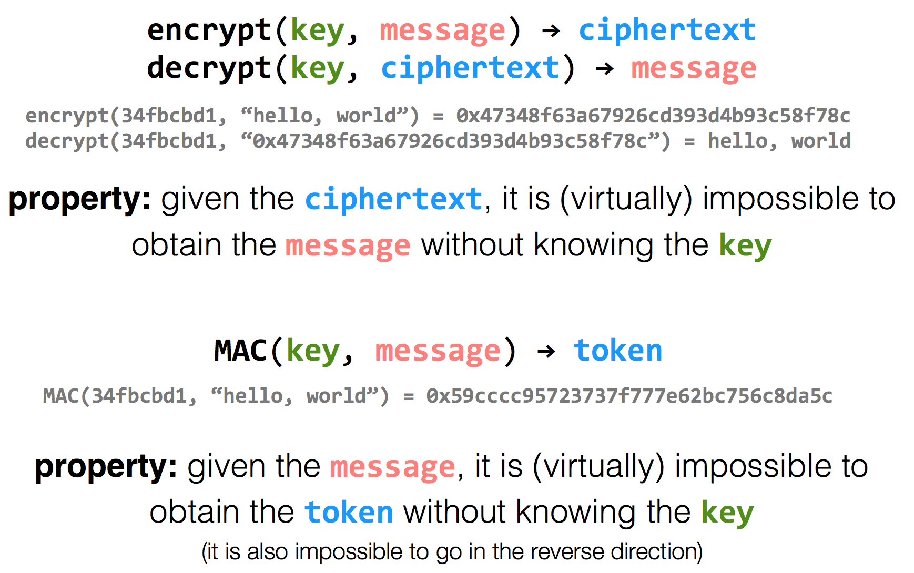
Encryption Properties

Slide 7
k=key
m=message
Alice
Bob
c = encrypt(k, m)
h = MAC(k, m)
c | h
m = decrypt(k, c)
MAC(k, m) == h ?

Slide 8
Alice
Eve
Bob
c = encrypt(k, m)
h = MAC(k, m)
c | h
m = decrypt(k, c)
MAC(k, m) == h ?
c | h
Problem: replay attacks (adversary could intercept a message, re-send it at a later time)
c | h

Slide 9
Alice
Bob
c = encrypt(k, m | seq)
h = MAC(k, m | seq)
c | h
m | seq = decrypt(k, c)
MAC(k, m | seq) == h ?

Slide 10
Alice
Eve
Bob
c = encrypt(k, m | seq)
h = MAC(k, m | seq)
c | h
m | seq = decrypt(k, c)
MAC(k, m | seq) == h ?
c | h
problem: reflection attacks (adversary could intercept a message, re-send it later in the opposite direction)
Notes:
But if receiver is also sending to the sender (i.e., if they're both sending), the receiver might use that sequence number. So adversary could replay in the other direction (a "reflection" attack) - Solution: Use different keys in each direction

Slide 11
Alice
Bob
c_{a} = encrypt(k_{a}, m_{a} | seq_{a})
h_{a} = MAC(k_{a}, m_{a} | seq_{a})
c_{a} | h_{a}
m_{a} | seq_{a} = decrypt(k_{a}, c_{a})
MAC(k_{a}, m_{a} | seq_{a}) == h_{a} ?
c_{b} = encrypt(k_{b}, m_{b} | seq_{b})
h_{b} = MAC(k_{b}, m_{b} | seq_{b})
c_{b} | h_{b}
m_{b} | seq_{b} = decrypt(k_{b}, c_{b})
MAC(k_{b}, m_{b} | seq_{b}) == h_{b} ?

Slide 12
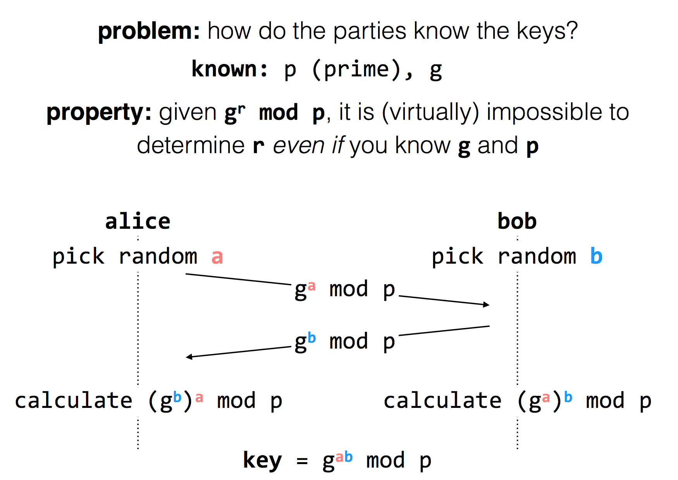

Slide 13
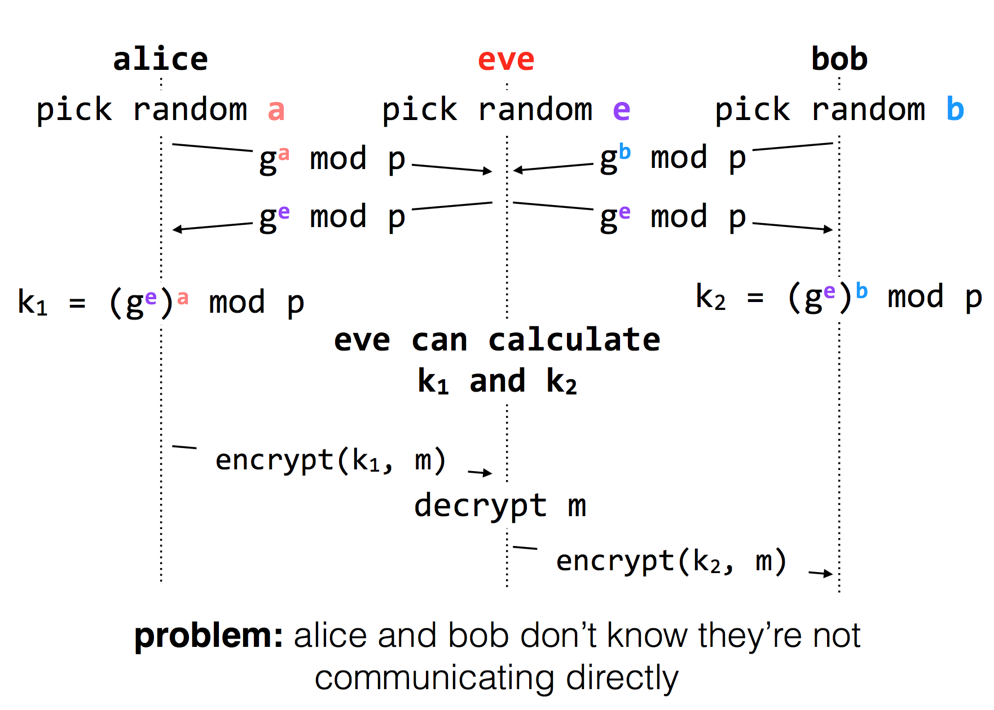
Diffie-Hellman Key Exchange

Slide 14
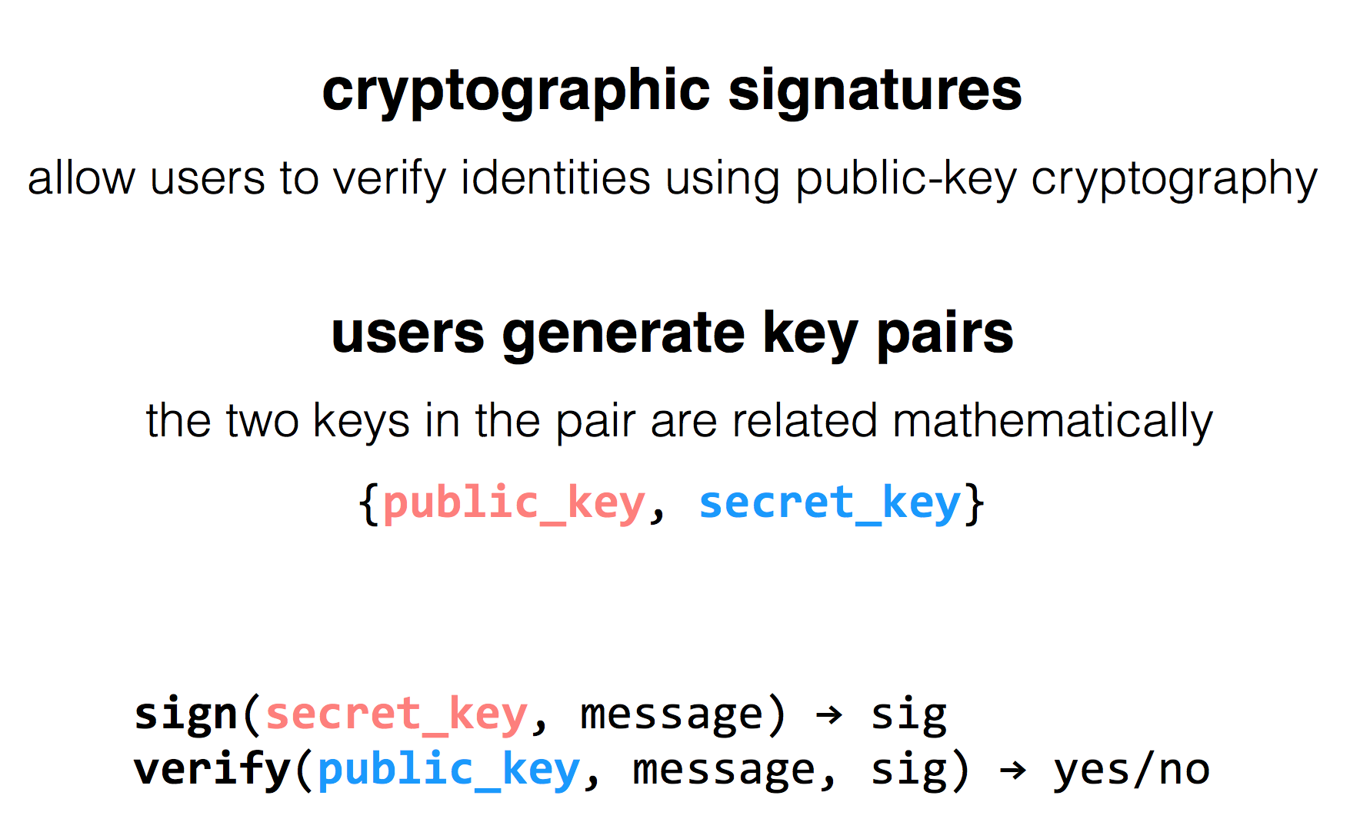
RSA Algorithm

Slide 15
Public Key Distribution
1. Alice remembers the key she used last time
Easy to implement
Effective against subsequent man-in-the-middle attacks
Doesn't protect against MITM attacks the first time around
Doesn't allow parties to change keys
2. Consult some authority that knows everyone's public key
Does not scale (client asks for a PK for every new name)
Alice needs server's public key beforehand

Slide 16
Public Key Distribution
3. Authority, but pre-compute responses
Authority creates signed messages: {Bob, PK_bob}_{SK_as}
Anyone can verify the authority signed this message, given PK_as
When Alice wants to talk to Bob, she needs a signed message from the authority, but it doesn't matter where this message comes from as long as the signature checks out
I.e., Alice could retrieve the message from a different server
This signed message is a certificate
More scalable

Slide 17
Two Types of Encryption
Symmetric key encryption
Single key (symmetric) is shared between parties, kept secret from everyone else
Ciphertext = (M)^K
Asymmetric key encryption
Keys come in pairs, public and private
Secret: (M)^K-public
Authentic: (M)^K-private

Slide 18
Questions on Certificate Authorities
Who should run the certificate authority?
How does the browser get this list of CAs?
Generally they come with the browser
How does the CA build its table of names <-> public keys?
Have to agree on how to name principals, and
Need a mechanism to check that a key corresponds to a name
What if a CA makes a mistake?
Need a way to revoke certificates: Expiration date? Not useful for immediate problems
Publish certificate revocation list? Works in theory, not as well in practice
Query online server to check certificate freshness? Not a bad idea
Notes:
Alternative: avoid CAs by using public keys as names (protocols: SPKI/SDSI)
Works well for names that users do not have to remember/enter

Slide 19
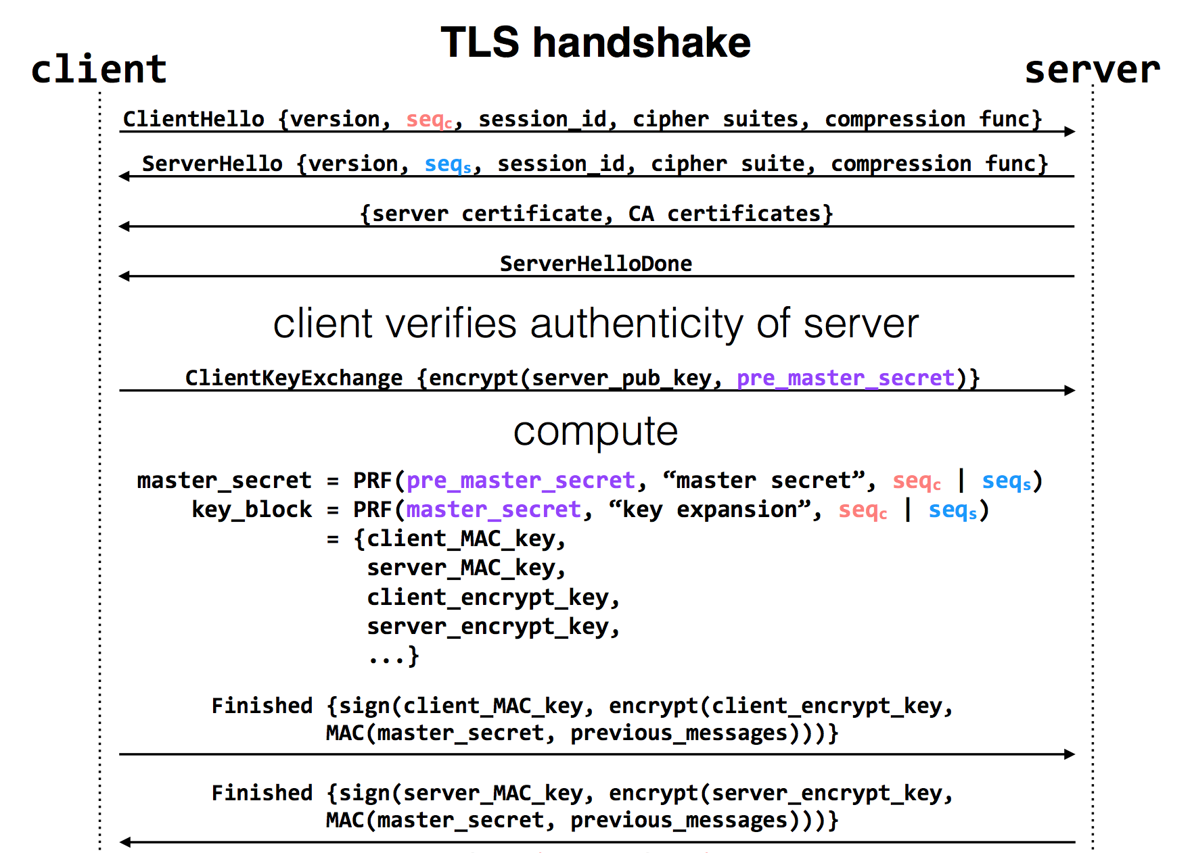
Notes:
pre-master-key is a random number
PRF: pseudo random function
Master key is a 48-byte sequence
https://crypto.stackexchange.com/questions/1139/what-is-the-purpose-of-four-different-secrets-shared-by-client-and-server-in-ssl

Slide 20
Local Security

Slide 21
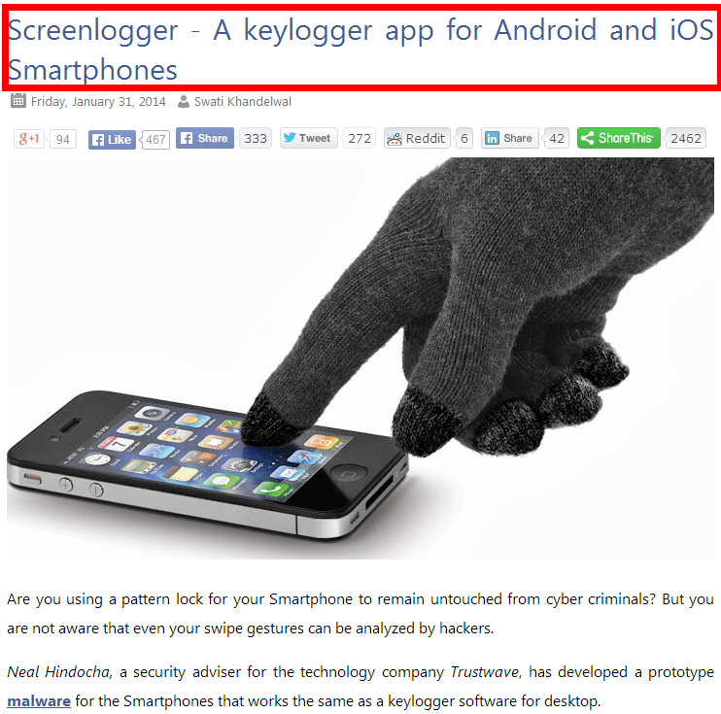
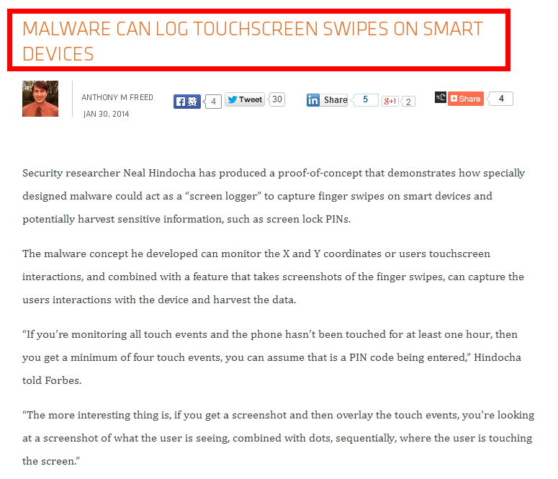
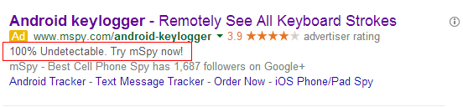
Ways an Attacker Can Steal Your Secrets
KeyLogger: install a KeyLogger/TouchLogger on the phone
Li, Wenhao, et al. "Building trusted path on untrusted device drivers for mobile devices." APSys, 2014.
Notes:
here is a list of how an attacker can steal your secret data. The attacker can install a kerlogger on the phone and steal everything you just input. You can buy that service on ebay.

Slide 22
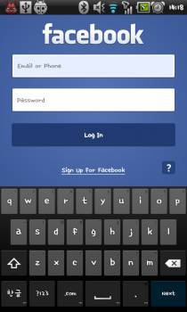
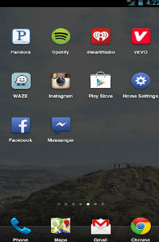
Ways an Attacker Can Steal Your Secrets
KeyLogger: install a KeyLogger/TouchLogger on the phone
Phishing: install a malware and lure the user to enter password
Malicious app
in background,
waiting for the
Facebook app
to launch
Once Facebook app starts, the malicious app will get active and make itself cover the real UI
Bianchi, Antonio, et al. "What the App is That? Deception and Countermeasures in the Android User Interface.", S&P 2015.
Notes:
Or he can install a malware to lure the user to enter password. A typicall malware will run in background...

Slide 23

Ways an Attacker Can Steal Your Secrets
KeyLogger: install a KeyLogger/TouchLogger on the phone
Phishing: install a malware and lure the user to enter password
MemScan: use rootkit and scan the memory for any plaintext
010100101010101000101010101010101010101010101010010101010101010010101010101010101001010011010101010101010101010001001000000101010010010010
The Samsung memory mapping bug: http://forum.xda-developers.com/showthread.php?t=2048511
Notes:
Or, he can just use rootkit and scan the memory for any plaintext

Slide 24
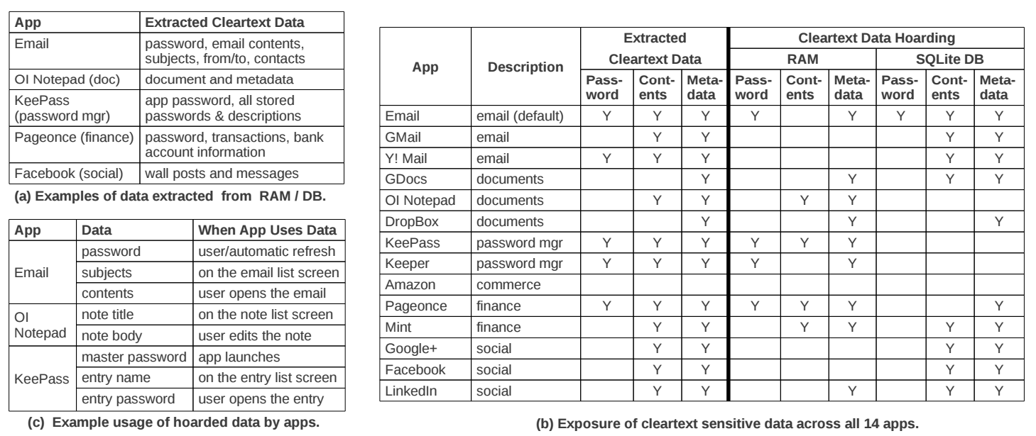
The "Data Residue" Problem
The plaintext of confidential data may exist in memory on a mobile device for a long time
应用对关键数据的保护不够
引CleanOS的数据
Android's default Email app:
has plaintext of password in RAM 10 minutes after login
Tang, Yang, et al. "CleanOS: Limiting Mobile Data Exposure with Idle Eviction." OSDI. 2012.
Notes:
This attack is simple but effective since the memory does contain many secrets. Here is a table from cleanOS, OSDI'12 paper.
It shows that many popular applications will leave residue of critical data in memory for a long time. For example,
the android's default email app,

Slide 25
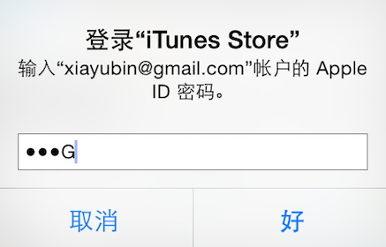
Ways an Attacker Can Steal Your Secrets
KeyLogger: install a KeyLogger/TouchLogger on the phone
Phishing: install a malware and lure the user to enter password
MemScan: use rootkit and scan the memory for any plaintext
ScreenCapture: get information directly from the screen
Jang, Yeongjin, et al. "A11y Attacks: Exploiting Accessibility in Operating Systems." CCS, 2014.
Notes:
The attacker might also steal your password from screen. On iOS system, once you enter a password, the last character will be displayed for a second. If the attacker can access framebuffer or capture the screen, he can get your password

Slide 26
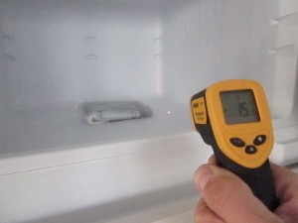
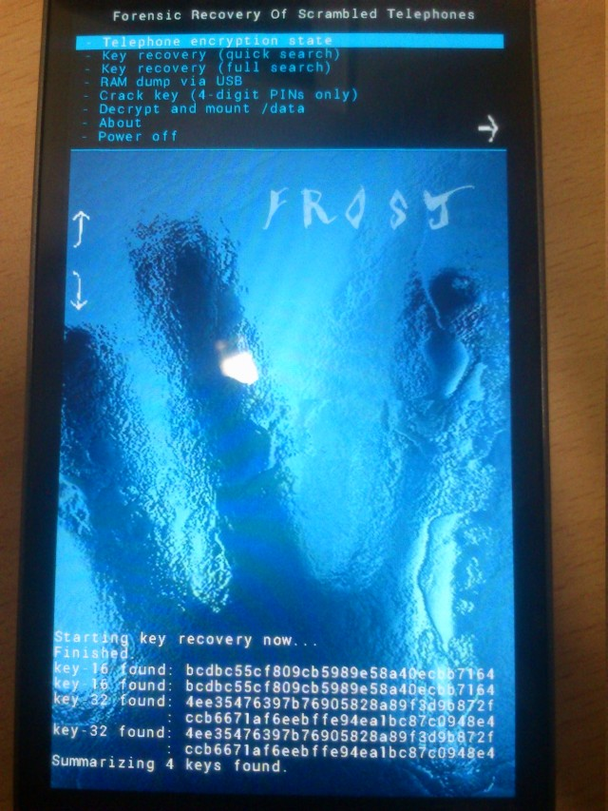
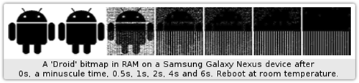
Ways an Attacker Can Steal Your Secrets
KeyLogger: install a KeyLogger/TouchLogger on the phone
Phishing: install a malware and lure the user to enter password
MemScan: using rootkit and scan memory for any plaintext
ScreenCapture: get information directly from the screen
Cold-boot: physically attack that can scan memory to get any plaintext
Müller, Tilo, and Michael Spreitzenbarth. "Frost." Applied Cryptography and Network Security. Springer Berlin Heidelberg, 2013.
Notes:
Cold boot attack is also possible on the mobile device, which just scan the memory to get an plaintext.

Slide 27
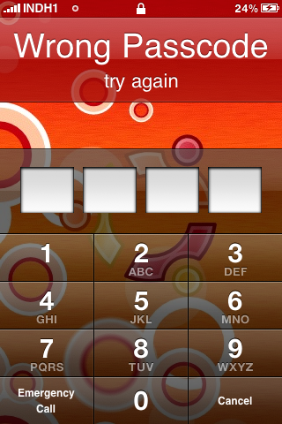
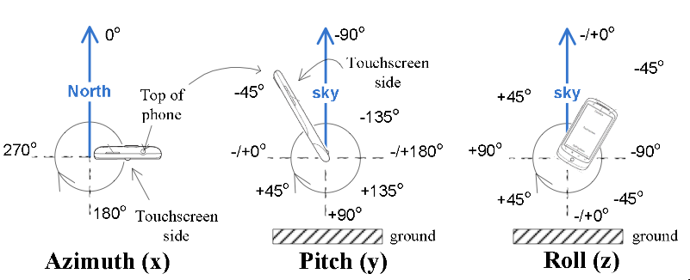
Ways an Attacker Can Steal Your Secrets
KeyLogger: install a KeyLogger/TouchLogger on the phone
Phishing: install a malware and lure the user to enter password
MemScan: using rootkit and scan memory for any plaintext
ScreenCapture: get information directly from the screen
Coldboot: physically scan the memory to get any plaintext
Side-Channel: infer PIN code through motion-detector
Cai, Liang, and Hao Chen. "TouchLogger: Inferring Keystrokes on Touch Screen from Smartphone motion." HotSec. 2011.
Notes:
A even more sophistic attack is to use the motion-detector to guess the user's PIN code, just by learning the relationship between the PIN and phone's inclination when pressing the screen.

Slide 28
Taint Tracking
Data Protection

Slide 29
Data Lifetime
The lifetime of sensitive data should be minimized
The longer data remains in memory the greater its chances of being leaked to disk
Swapping, hibernation, VM suspending, core dump, etc.
That's what we called "data exposure"

Slide 30
Tainting: Data Flow Tracking
Apply access policy along the data flow
E.g., a password cannot be sent to Internet
E.g., credit card number cannot be sent to other apps
E.g., untrusted data cannot be executed

Slide 31
Dynamic Taint Analysis
i = get_input();
two = 2;
if(i%2 == 0){
j = i+two;
l = j;
} else {
k = two*two;
l = k;
}
jmp l;
Example sourced from CMU ECE
Source
Will show the basic approach of dynamic taint analysis
Two concrete executions will be presented
Goal: evaluate whether control can be hijacked by [malicious] user input

Slide 32
Dynamic Taint Analysis
i = get_input();
two = 2;
if(i%2 == 0){
j = i+two;
l = j;
} else {
k = two*two;
l = k;
}
jmp l;
Variable | Value | Taint Status

Slide 33
Dynamic Taint Analysis
i = get_input();
two = 2;
if(i%2 == 0){
j = i+two;
l = j;
} else {
k = two*two;
l = k;
}
jmp l;
Variable | Value | Taint Status
i | 6 | true

Slide 34
Dynamic Taint Analysis
i = get_input();
two = 2;
if(i%2 == 0){
j = i+two;
l = j;
} else {
k = two*two;
l = k;
}
jmp l;
Variable | Value | Taint Status
i | 6 | true
two | 2 | false

Slide 35
Dynamic Taint Analysis
i = get_input();
two = 2;
if(i%2 == 0){
j = i+two;
l = j;
} else {
k = two*two;
l = k;
}
jmp l;
Variable | Value | Taint Status
i | 6 | true
two | 2 | false
j | 8 | true

Slide 36
Dynamic Taint Analysis
i = get_input();
two = 2;
if(i%2 == 0){
j = i+two;
l = j;
} else {
k = two*two;
l = k;
}
jmp l;
Variable | Value | Taint Status
i | 6 | true
two | 2 | false
j | 8 | true
l | 8 | true
Notes:
In this case, the taint analysis would show that an attack is possible. Notice, however, that we don't know exactly how variable L is tainted by variable I as we do in a fully symbolic execution—we only know that the two variables are related. However, computing a fully symbolic execution is often intractable, thus giving dynamic taint analysis some merits as a higher-performance technique (in terms of computational efficiency).

Slide 37
Dynamic Taint Analysis
i = get_input();
two = 2;
if(i%2 == 0){
j = i+two;
l = j;
} else {
k = two*two;
l = k;
}
jmp l;
Variable | Value | Taint Status

Slide 38
Dynamic Taint Analysis
i = get_input();
two = 2;
if(i%2 == 0){
j = i+two;
l = j;
} else {
k = two*two;
l = k;
}
jmp l;
Variable | Value | Taint Status
i | 7 | true

Slide 39
Dynamic Taint Analysis
i = get_input();
two = 2;
if(i%2 == 0){
j = i+two;
l = j;
} else {
k = two*two;
l = k;
}
jmp l;
Variable | Value | Taint Status
i | 7 | true
two | 2 | false

Slide 40
Dynamic Taint Analysis
i = get_input();
two = 2;
if(i%2 == 0){
j = i+two;
l = j;
} else {
k = two*two;
l = k;
}
jmp l;
Variable | Value | Taint Status
i | 7 | true
two | 2 | false
k | 4 | false

Slide 41
Dynamic Taint Analysis
i = get_input();
two = 2;
if(i%2 == 0){
j = i+two;
l = j;
} else {
k = two*two;
l = k;
}
jmp l;
Variable | Value | Taint Status
i | 7 | true
two | 2 | false
k | 4 | false
l | 4 | false
Notes:
In this case, the taint analysis would show that an attack is not possible.

Slide 42
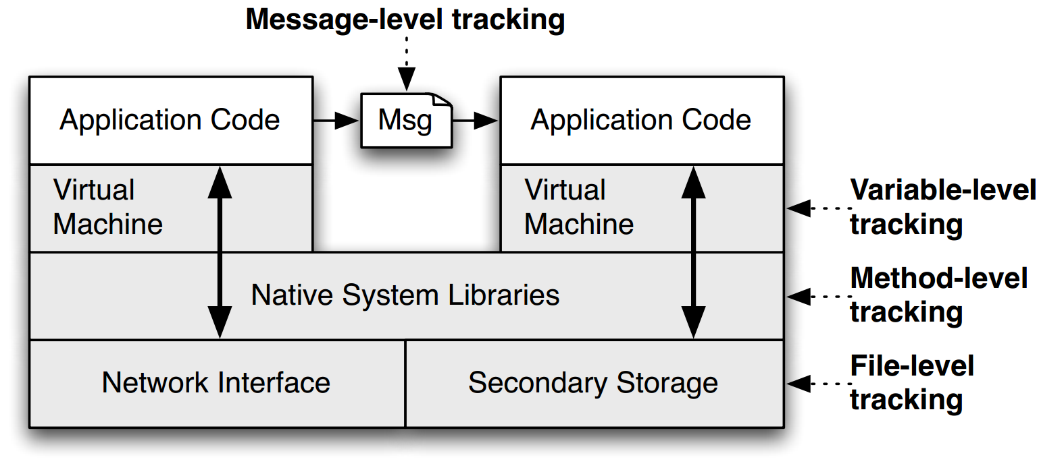
TaintDroid
Notes:
This is a figure from the conference paper describing TaintDroid. It shows where, at a high level, the various kinds of taint analysis are done. There are 4 "granularities" of taint analysis used in TaintDroid, including message-level, variable-level, method-level, and file-level.

Slide 43
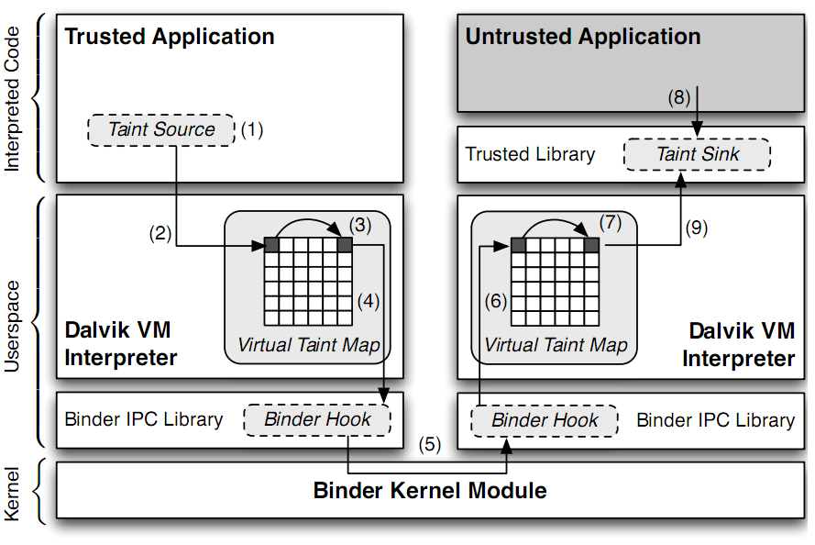
TaintDroid Data Flow
Notes:
Sensitive information is ﬁrst identiﬁed at a taint source, where a taint marking indicating the information type is assigned. Dynamic taint
analysis tracks how labeled data impacts other data in a way that might leak the original sensitive information.
Finally, the impacted data is identiﬁed before it leaves the system at a taint sink (usually the network interface).
possible false positive

Slide 44
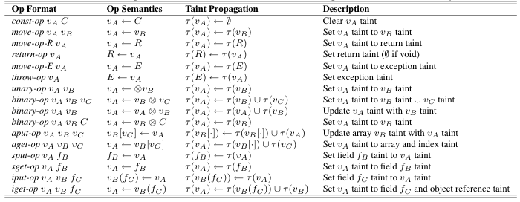
Taint Propagation

Slide 45
Bug from Input

Slide 46
How does a Hacker Search a Bug?
Step-0: Chose a library (open-source, of course)
Let's try ffmpeg, which is used in Chrome, VLC, Mplayer...
There are also rumors that YouTube uses it for conversion
Step-1: List the demuxers of ffmpeg
Step-2: Identify the input data
Step-3: Trace the input data

Slide 47
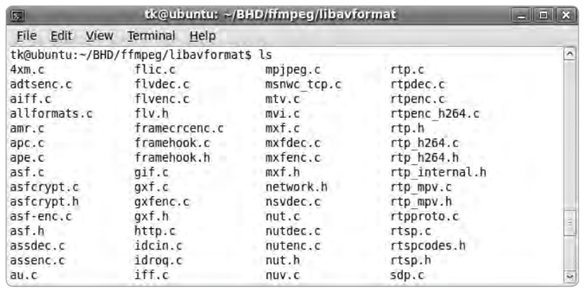
Step-1: List the Demuxers of FFmpeg

Slide 48

Step-2: Identify the Input Data
demuxername_read_header()
Most demuxers declear a function called it
Takes a parameter of type AVFormatContext
This function initializes a pointer:
Many different get_something() are used to extract pb data
E.g., get_le32(), get_buffer()
Conclusion: pb is a pointer to the input data of media files

Slide 49
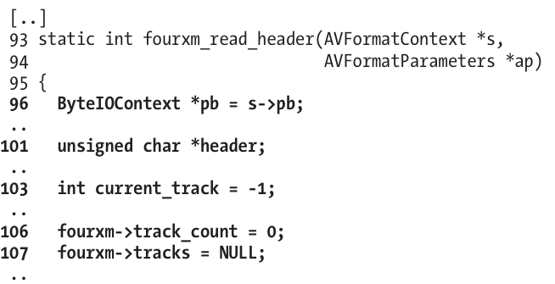
Step-3: Trace the Input Data
Start to read the first demuxer: libavformat/4xm.c

Slide 50
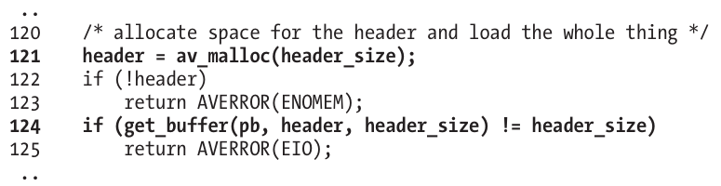
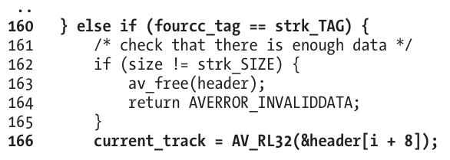
int
unsigned int

Slide 51
Step-3: Trace the Input Data
Supplying a value >= 0x80000000 for current_track causes a change in sign that results in current_track being interpreted as negative
The if statement in line 167 will always return FALSE
Thus, the buffer allocation in line 171 will never be reached

Slide 52
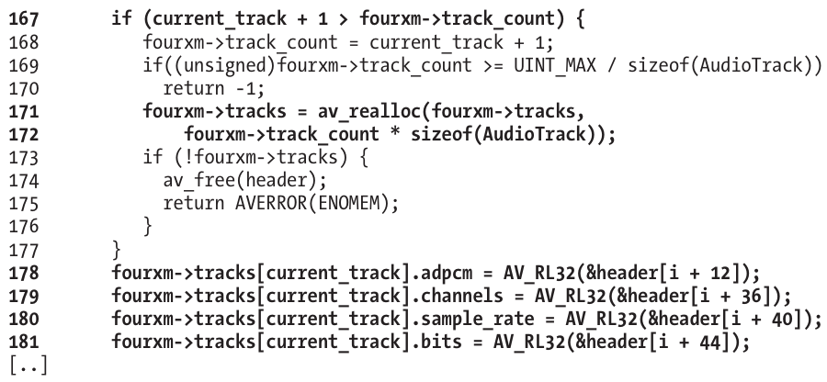
Step-3: Trace the Input Data

Slide 53
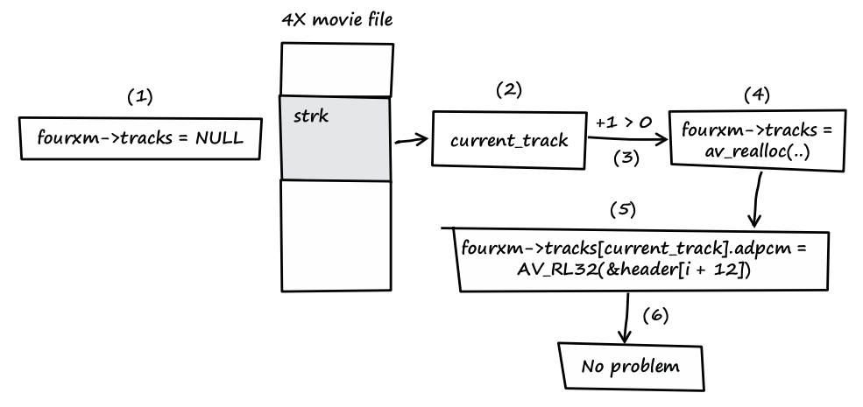
Step-3: Trace the Input Data
Notes:
fourxm->tracks is initialized with NULL (see line 107).
If the processed media file contains a strk chunk, the value of current_track is extracted from the user-controlled data of the chunk (see line 166).
If the value of current_track + 1 is greater than zero, a heap buffer is allocated.
The heap buffer pointed to by fourxm->tracks is allocated (see lines 171 and 172).
Data from the media file is copied into the heap buffer, while current_track is used as an array index into the buffer (see lines 178–181).
When this behavior occurs, there is no security problem.

Slide 54
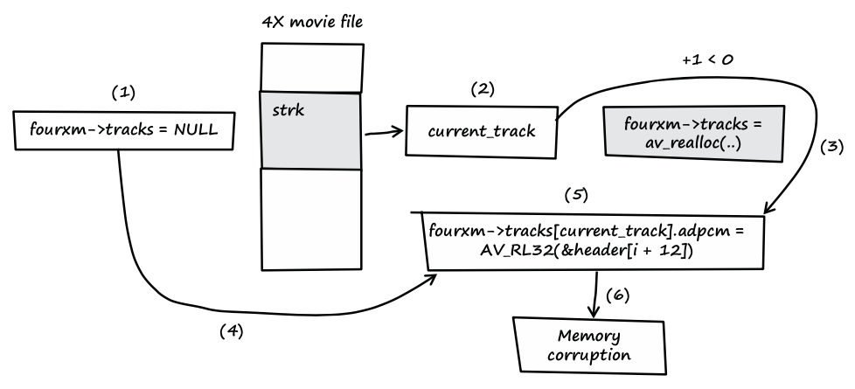
Step-3: Trace the Input Data
Notes:
fourxm->tracks is initialized with NULL (see line 107).
If the processed media file contains a strk chunk, the value of current_track is extracted from the user-controlled data of the chunk (see line 166).
If the value of current_track + 1 is less than zero, the heap buffer isn't allocated.
fourxm->tracks still points to memory address NULL.
The resulting NULL pointer is then dereferenced by the user- controlled value of current_track, and four 32-bit values of user- controlled data are assigned to the dereferenced locations (see lines 178–181).
Four user-controlled memory locations can be overwritten with four user-controlled data bytes each.

Slide 55
Question
How can we use taint tracking to find such bugs?

Slide 56

TaintCheck: Basic Ideas
Program execution normally derived from trusted sources, not attacker input
Mark all input data to the computer as "tainted" (e.g., network, stdin, etc.)
Monitor program execution and track how tainted data propagates (follow bytes, arithmetic operations, jump addresses, etc.)
Detect when tainted data is used in dangerous ways

Slide 57
Add Taint Checking code
TaintCheck first runs the code through an emulation environment (Valgrind) and adds instructions to monitor tainted memory
X86 instructions
UCode
Binary re-writer
Taint Check
X86 instructions
UCode
Dynamic taint analysis

Slide 58
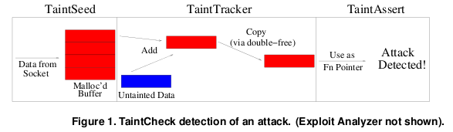
TaintCheck Detection Modules
TaintSeed: Mark untrusted data as tainted
TaintTracker: Track each instruction, determine if result is tainted
TaintAssert: Check is tainted data is used dangerously

Slide 59
Performance Evaluation – CPU Bound Process
Hardware: 2.00 GHz Pentium 4, 512 MB RAM, RedHat 8.0
Application: bzip2(15mb)
Normal runtime 8.2s
Valgrind nullgrind skin runtime: 25.6s (3.1x)
Memcheck runtime: 109s (13.3x)
TaintCheck runtime: 305s (37.2x)

Slide 60
Performance Overhead of Apache
A more representative case, network and I/O

Slide 61
Related Research Projects

Slide 62
CleanOS: Add New Abstraction SDO
Applications create SDOs and add sensitive data to them
CleanOS implements three functions for SDOs:
Tracks data in SDOs using taint tracking
Evicts SDOs to a trusted cloud whenever idle
Decrypts SDO data when it is accessed again
Email App
Email App
Content SDO
Password
SDO
Content
SDO
Password
SDO
evicted
when user reads an email
when the app goes to the background

Slide 63
The SDO Abstraction
An SDO is a logical collection of Java objects that contain sensitive data and that are related somehow
Email-password SDO: password string + all objects computed from it
Email-contents SDO: all emails in a thread
Bank-account SDO: all transactions in an account
human-readable and used for auditing
class SDO {
SDO(String description, ...); // create SDO
void add(Object o); // adds object to SDO
void remove(Object o); // removes object from SDO
…
private int sdoID; // unique ID for SDO
}
human-readable and used for auditing

Slide 64


TinMan's Idea: How about no secret on a phone?
TinMan: Android without a cor
Nothing to protect!

Slide 65
Migrate Confidential Data Access to a Trusted Node
Security-oriented offloading
An app is migrated to the trusted node when accesses cor
The offloading engine is based on COMET ^{[OSDI'12]}
try to access cor
Phone
migrate
migrate back
Trusted-server
access cor
finish access
Notes:
The basic idea is to adopt security-oriented offloading. An app is offloaded to xxx, migrated back...

